Slide 2

Mission
Giter Dun analyzes startup / early-stage company datasets to identify shared traits and characteristics across the companies.

Slide 3

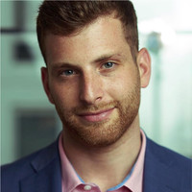


Slide 10
THE TEAM
Group Member
Group Member
Group Member
Team Lead
Charles Biggar
Don Leshem
Drew Seelig
Omar Eltorai

Slide 4
TOC
Methodology
Summary
Data Review
Plot of count of companies vs. funding amounts
Total Funding by Category by City

Slide 5
Methodology
We identified our main data set of investor data
We then cleaned this data
We then pulled in weather data from weather api and combined with main data set
We then started to iterate on observations of the data

Slide 6
Summary
We have observed strong representations at the costs for funding of startups, let by San Francisco and New York City.
Initial thoughts of weather influencing funding success has not been observed.
California is the top state for start-ups which is in-line with the reputation it has.
Technology and Software lead the categories of start-ups and are widely spread throughout all states.
Top 10 Cities by Total Funding
City | State | Total Funding | Total Investors | Average of Max Temp(F)
San Francisco | CA | $58,849,838,747 | 12052 | 69.01
New York | NY | $33,405,582,745 | 7149 | 80.01
Palo Alto | CA | $13,587,652,470 | 1909 | 71.01
Mountain View | CA | $ 9,634,591,300 | 1692 | 71.01
Cambridge | MA | $ 9,589,144,334 | 1092 | 71.6
San Jose | CA | $ 9,110,671,511 | 906 | 87.8
San Diego | CA | $ 8,309,128,786 | 843 | 73.99
Boston | MA | $ 8,278,504,756 | 1503 | 78.01
Redwood City | CA | $ 7,970,115,831 | 945 | 71.01
Chicago | IL | $ 7,435,861,102 | 1020 | 72

Slide 7
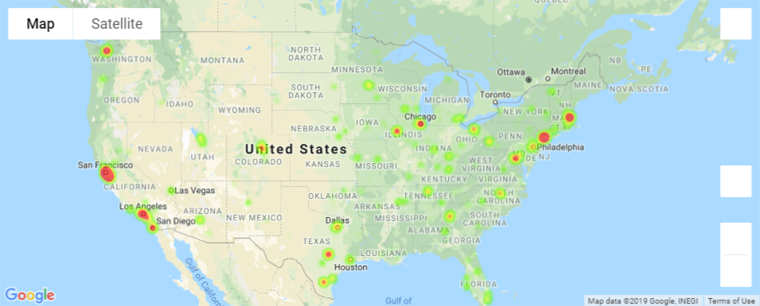
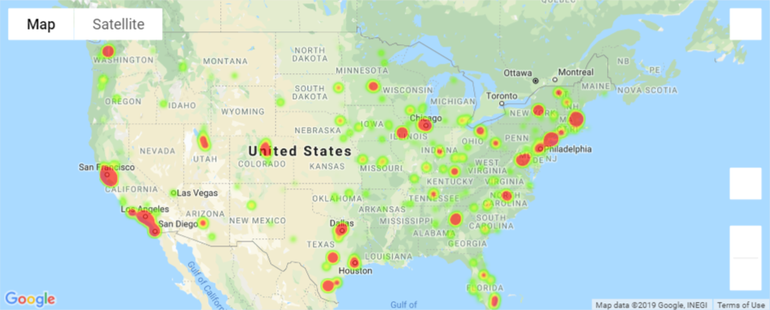
Plot of count of companies vs. funding amounts
We have observed a high number of companies in NY and CA, however total funding is more apparent in other states such as Colorado, Texas, Illinois, Washington and Florida.

Slide 8
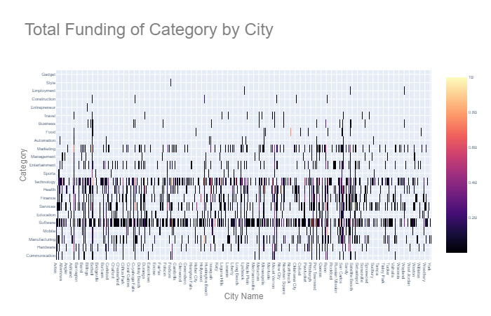
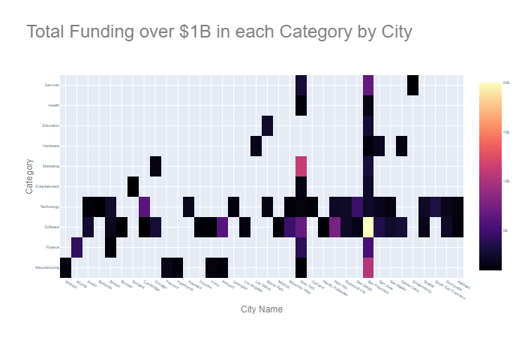

Total Funding by Category by City
We have observed technology and software as a popular category across all states. When we focus category funding to >$1B, we see New York and San Francisco as popular cities containing companies across most categories.

Slide 9
Questions?

